Slide 1

Mexico Education Compulsory Law
Emmie Zhang

Slide 2

Literature Review
Compulsory schooling laws specify an entry age by which the child is required to attend school and a dropout age at which the child can choose to unconditionally stop attending school.
Two primary types of exceptions:
have completed a specified number of schooling years
if they have secured employment and have also reached both minimum age and years of schooling requirements (Stephs & Yang 3).

Slide 3
Why do we care?
Oreopoulos and Salvanes (2011) note in their recent survey of the literature that there is a growing literature examining the effect of schooling across a variety of domains outside of the labor market including, but not limited to, health, crime, and family formation.
The OLS estimates in column (1) are all significant and in the expected direction with more schooling leading to increased wages, higher occupational prestige, and less unemployment.
https://www.nber.org/system/files/working_papers/w19369/w19369.pdf

Slide 4
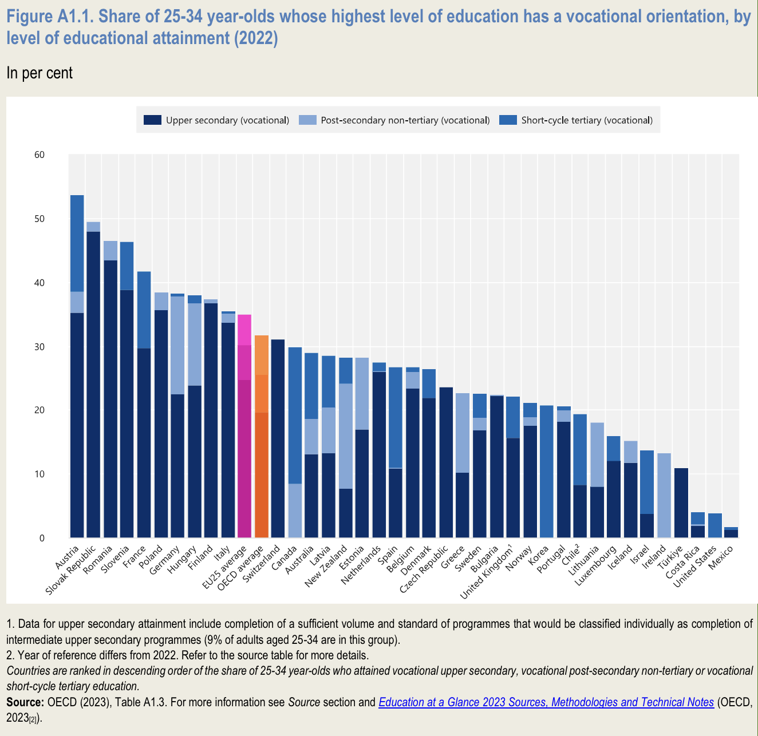
Why Mexico?
According to the Organisation for Economic Co-operation and Development (OECD), Mexico, 1% of younger adults have this level of educational attainment, while in Finland and Slovenia, the share is almost 40%, and it reaches 48% in the Slovak Republic.
Mexico has the highest out-of-school rate among all OECD and partner countries, with around 29% of upper secondary-aged youth not enrolled in 2021
https://www.oecd-ilibrary.org/docserver/e13bef63-en.pdf?expires=1716938191&id=id&accname=ocid194641&checksum=A9108F8C5480E8389723E59050C4B54E

Slide 5
Mexico CSL Trajectory
1939 | Free, universal, primary education.
1942 | Post-war education rebuilding.
1946 | Removed socialist education.
1973 | Inclusivity and technological integration.
1993 | Compulsory lower and upper secondary school
2013 | Compulsory high school added to the period of free
2003-2018 | Rural secondary education growth.
2019 | Educational equity and modernization.

Slide 6
1993 CSL
lower and upper secondary education were made compulsory
Research Question: Does discontinuities occur in the secondary education attainment of urban and rural populations after the implementation of 1993 reformation?
Research Design:
Collecting survey data from IPUMS on Mexico census centered around the variables of birth year, educational attainment, gender, urban-rural status, and migration.
Assumed independence within and between the census samples’ populations.
Cleaning data in Stata, following standard academic procedures for reproducibility.
Performed linear regression on mean Secondary School education attainment rate by year search for a discontinuity.
Graph/map additional trends in the educational data across gender, urban & rural, and migration status.

Slide 7
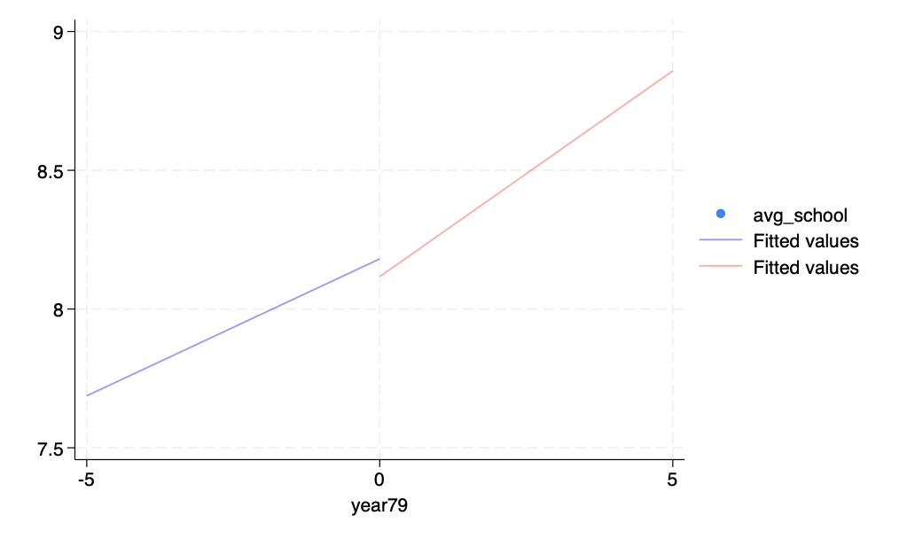
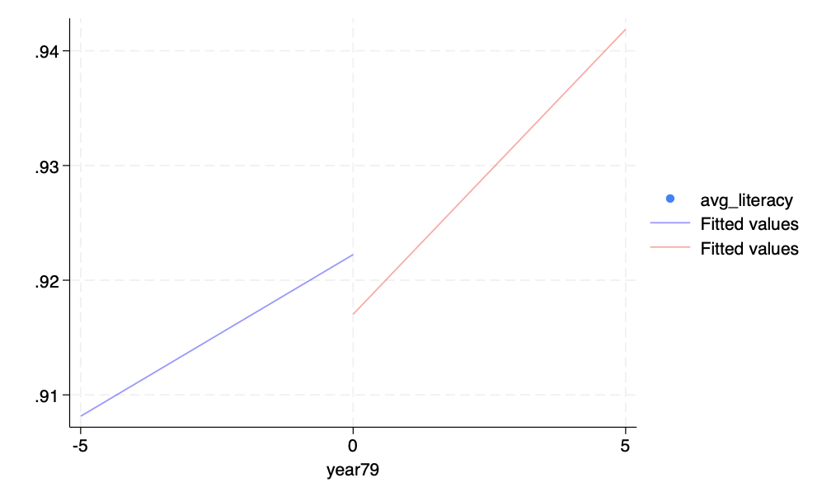
Observation
Literacy discontinuity
Discontinuity on Mean years of schooling

Slide 8
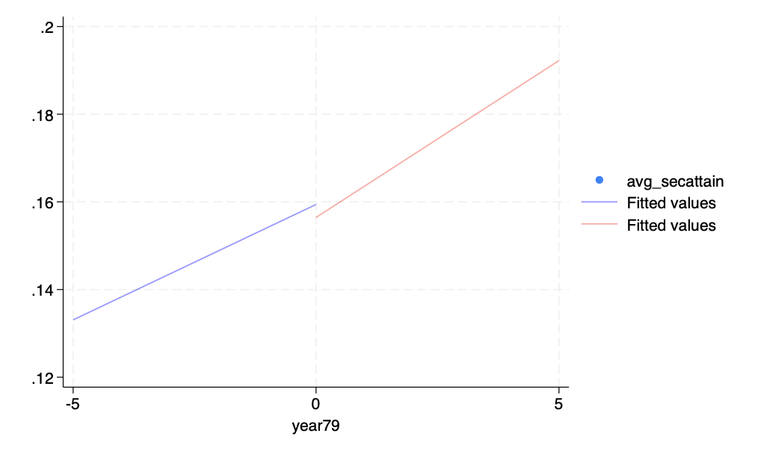
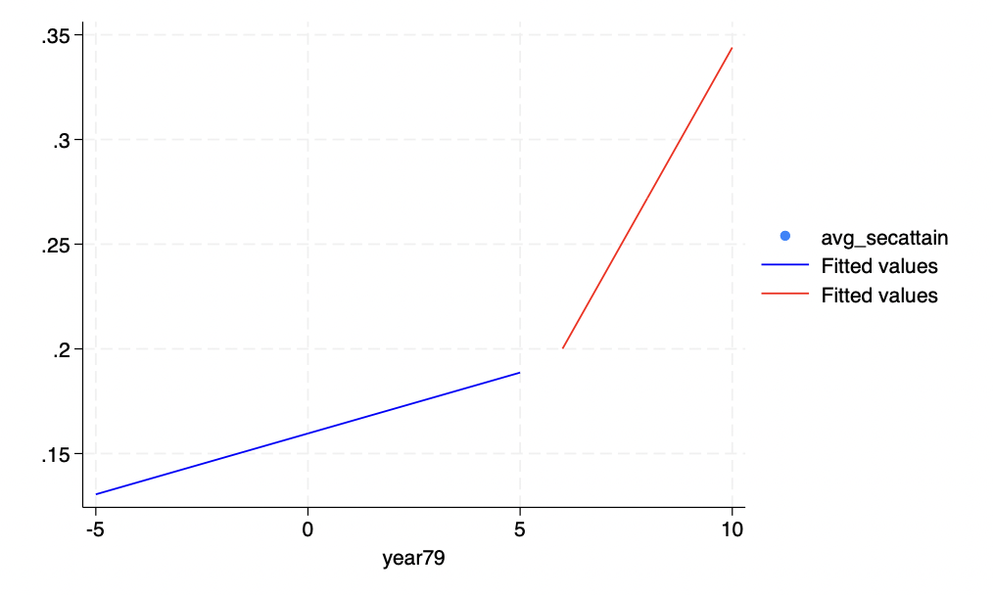
Observation
cutoff to a later year at 5
Discontinuity on Mean Secondary School Attainment

Slide 9
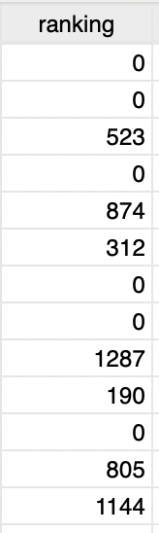
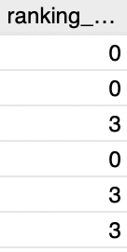
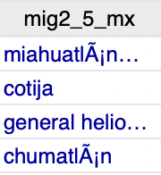
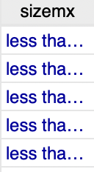
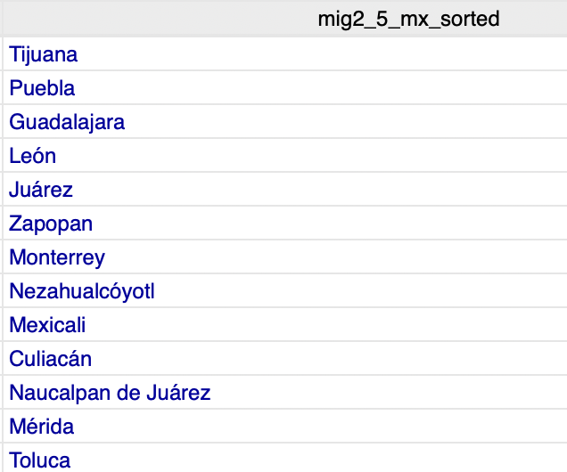
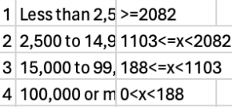
Migration

Slide 10
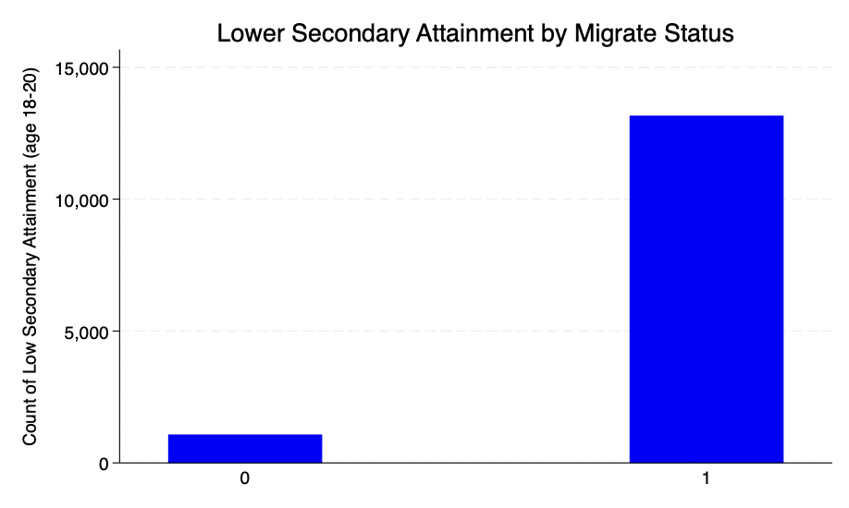
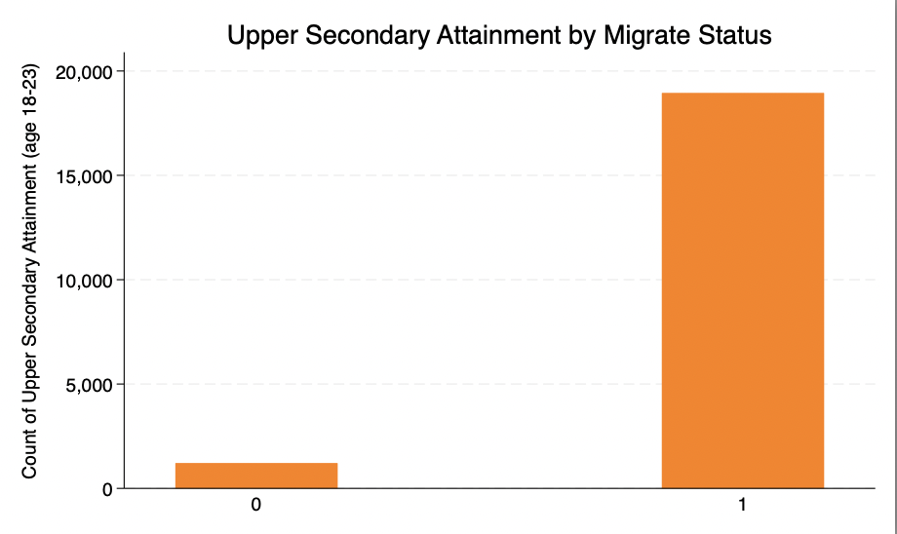
Compare effects on different cohorts
https://www.citypopulation.de/en/mexico/cities/

Slide 11
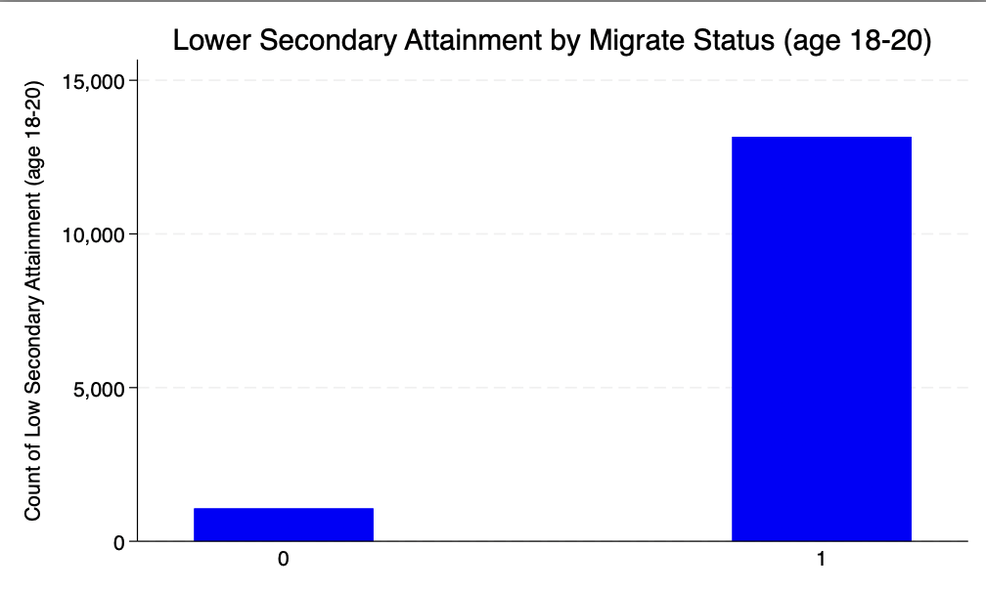
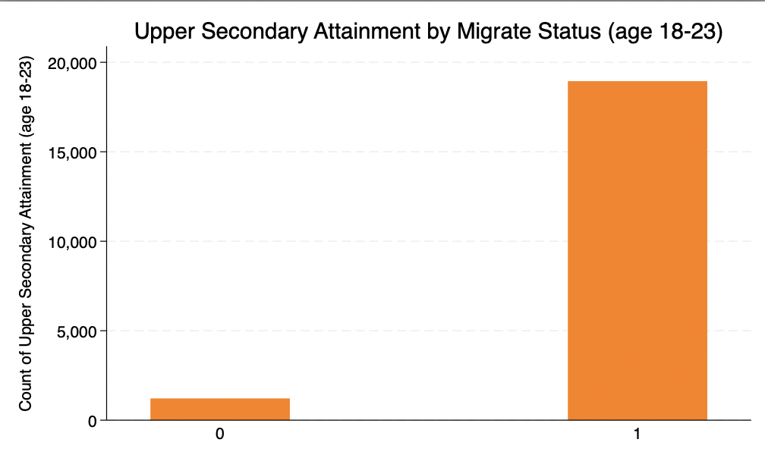
Compare effects on different cohorts

Slide 12
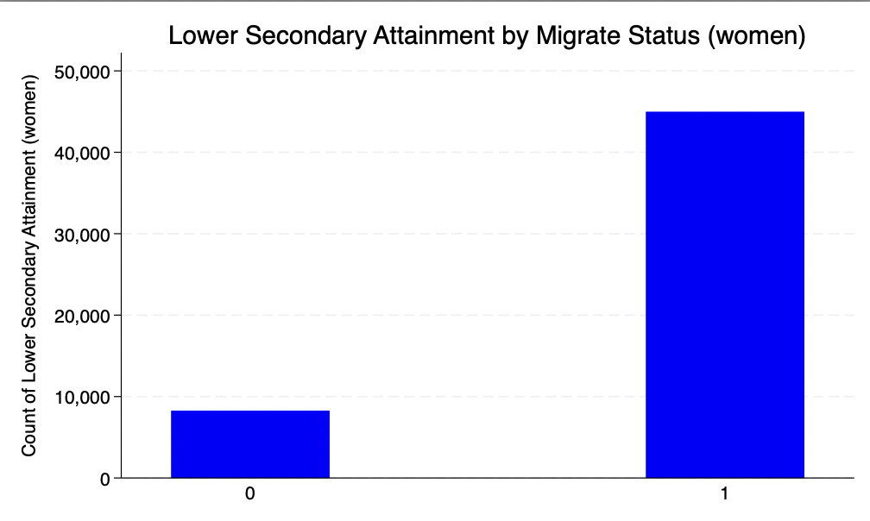
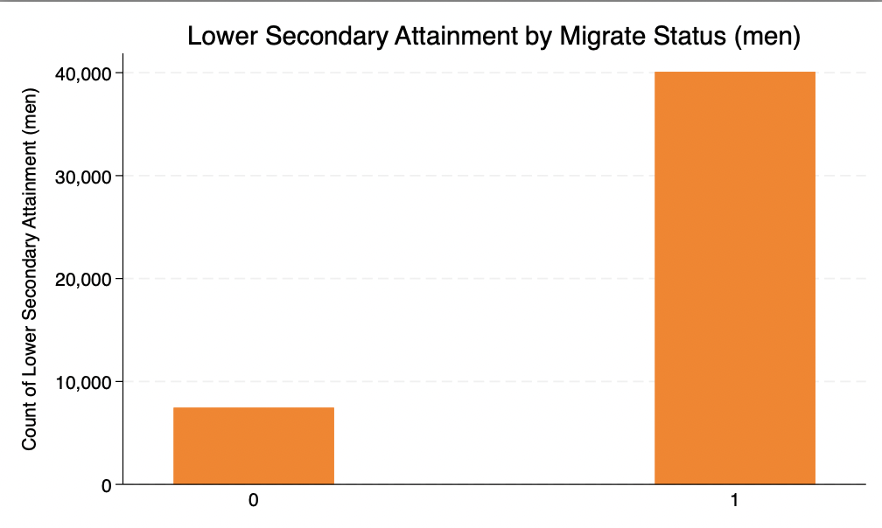
Compare effects on different cohorts

Slide 13
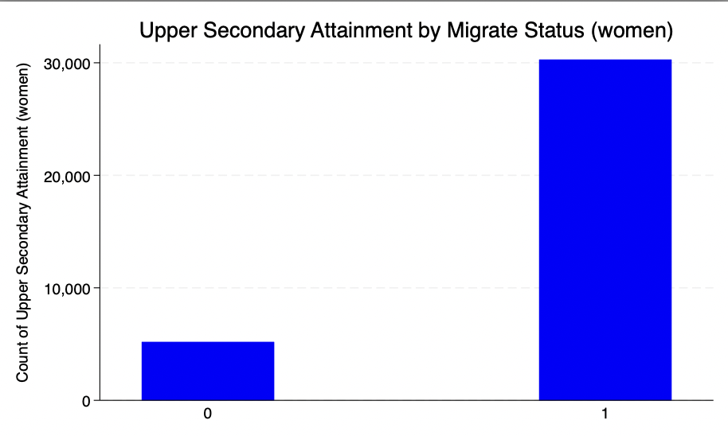
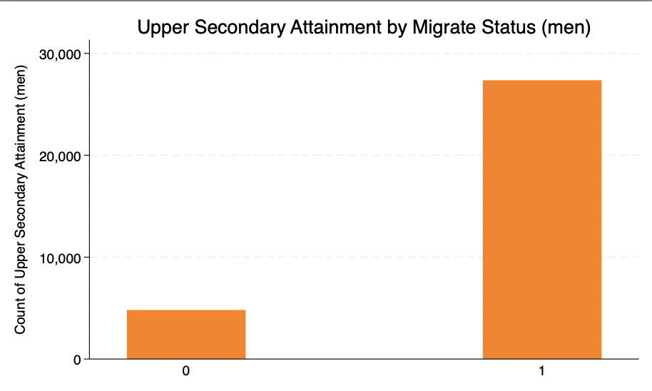
Compare effects on different cohorts

Slide 14
Question

